Slide 1
Decision Trees
Decision tree representation
ID3 learning algorithm
Entropy, information gain
Overfitting

Slide 2
Introduction
Goal: Categorization
Given an event, predict is category. Examples:
Who won a given ball game?
How should we file a given email?
What word sense was intended for a given occurrence of a word?
Event = list of features. Examples:
Ball game: Which players were on offense?
Email: Who sent the email?
Disambiguation: What was the preceding word?

Slide 3
Introduction
Use a decision tree to predict categories for new events.
Use training data to build the decision tree.
New
Events
Training
Events and
Categories
Decision
Tree
Category

Slide 4
Decision Tree for PlayTennis
Outlook
Sunny
Overcast
Rain
Humidity
Each internal node tests an attribute
High
Normal
Each branch corresponds to an
attribute value node
No
Yes
Each leaf node assigns a classification

Slide 5
Word Sense Disambiguation
Given an occurrence of a word, decide which sense, or meaning, was intended.
Example: "run"
run1: move swiftly (I ran to the store.)
run2: operate (I run a store.)
run3: flow (Water runs from the spring.)
run4: length of torn stitches (Her stockings had a run.)
etc.

Slide 6
Word Sense Disambiguation
Categories
Use word sense labels (run1, run2, etc.) to name the possible categories.
Features
Features describe the context of the word we want to disambiguate.
Possible features include:
near(w): is the given word near an occurrence of word w?
pos: the word’s part of speech
left(w): is the word immediately preceded by the word w?
etc.

Slide 7
Word Sense Disambiguation
Example decision tree:
(Note: Decision trees for WSD tend to be quite large)
pos
noun
verb
near(stocking)
near(race)
yes
no
yes
no
run4
run1
near(river)
yes
no
run3

Slide 8
WSD: Sample Training Data
Features |  |  |  | Word Sense
pos | near(race) | near(river) | near(stockings)
noun | no | no | no | run4
verb | no | no | no | run1
verb | no | yes | no | run3
noun | yes | yes | yes | run4
verb | no | no | yes | run1
verb | yes | yes | no | run2
verb | no | yes | yes | run3

Slide 9
Decision Tree for Conjunction
Outlook=Sunny ∧ Wind=Weak
Outlook
Sunny
Overcast
Rain
Wind
No
No
Strong
Weak
No
Yes

Slide 10
Decision Tree for Disjunction
Outlook=Sunny ∨ Wind=Weak
Outlook
Sunny
Overcast
Rain
Yes
Wind
Wind
Strong
Weak
Strong
Weak
No
Yes
No
Yes

Slide 11
Decision Tree for XOR
Outlook=Sunny XOR Wind=Weak
Outlook
Sunny
Overcast
Rain
Wind
Wind
Wind
Strong
Weak
Strong
Weak
Strong
Weak
Yes
No
No
Yes
No
Yes

Slide 12
Decision Tree
decision trees represent disjunctions of conjunctions
Outlook
Sunny
Overcast
Rain
Humidity
Yes
Wind
High
Normal
Strong
Weak
No
Yes
No
Yes
(Outlook=Sunny ∧ Humidity=Normal)
∨ (Outlook=Overcast)
∨ (Outlook=Rain ∧ Wind=Weak)

Slide 13
When to consider Decision Trees
Instances describable by attribute-value pairs
Target function is discrete valued
Disjunctive hypothesis may be required
Possibly noisy training data
Missing attribute values
Examples:
Medical diagnosis
Credit risk analysis
Object classification for robot manipulator (Tan 1993)

Slide 14
Top-Down Induction of Decision Trees ID3
A ← the “best” decision attribute for next node
Assign A as decision attribute for node
For each value of A create new descendant
Sort training examples to leaf node according to
the attribute value of the branch
If all training examples are perfectly classified (same value of target attribute) stop, else iterate over new leaf nodes.

Slide 15
Which attribute is best?
[29+,35-]
A₁=?
A₂=?
[29+,35-]
G
H
L
M
[21+, 5-]
[8+, 30-]
[18+, 33-]
[11+, 2-]

Slide 16
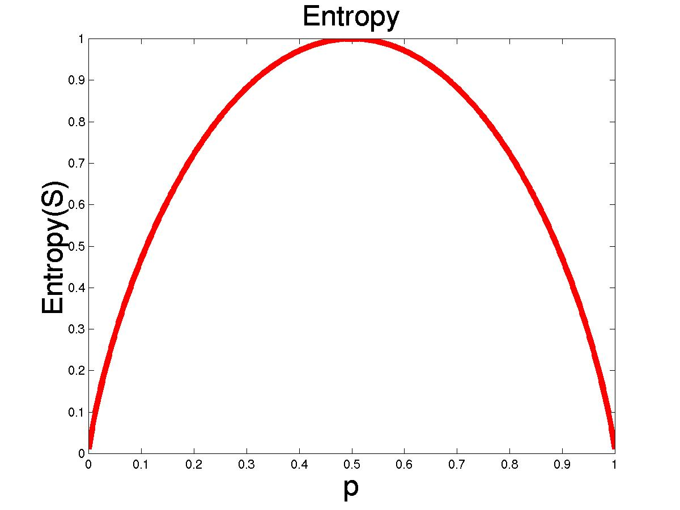
Entropy
S is a sample of training examples
p₊ is the proportion of positive examples
p₋ is the proportion of negative examples
Entropy measures the impurity of S
Entropy(S) = -p₊ log₂ p₊ - p₋ log₂ p₋

Slide 17
Entropy
Entropy(S)= expected number of bits needed to encode class (+ or -) of randomly drawn members of S (under the optimal, shortest length-code)
Why?
Information theory optimal length code assign
–log₂ p bits to messages having probability p.
So the expected number of bits to encode
(+ or -) of random member of S:
-p₊ log₂ p₊ - p₋ log₂ p₋

Slide 18

Information Gain (S=E)
Gain(S,A): expected reduction in entropy due to sorting S on attribute A
Entropy([29+,35-]) = -29/64 log2 29/64 – 35/64 log2 35/64
= 0.99
[29+,35-]
A₁=?
A₂=?
[29+,35-]
G
H
True
False
[21+, 5-]
[8+, 30-]
[18+, 33-]
[11+, 2-]

Slide 19
Information Gain
Entropy([18+,33-]) = 0.94
Entropy([11+,2-]) = 0.62
Gain(S,A2)=Entropy(S)
-51/64*Entropy([18+,33-])
-13/64*Entropy([11+,2-])
=0.12
Entropy([21+,5-]) = 0.71
Entropy([8+,30-]) = 0.74
Gain(S,A₁)=Entropy(S)
-26/64*Entropy([21+,5-])
-38/64*Entropy([8+,30-])
=0.27
[29+,35-]
A₁=?
A₂=?
[29+,35-]
True
False
True
False
[21+, 5-]
[8+, 30-]
[18+, 33-]
[11+, 2-]

Slide 20
Training Examples
Day
Outlook
Temp.
Humidity
Wind
Play Tennis
D1
Sunny
Hot
High
Weak
No
D2
Sunny
Hot
High
Strong
No
D3
Overcast
Hot
High
Weak
Yes
D4
Rain
Mild
High
Weak
Yes
D5
Rain
Cool
Normal
Weak
Yes
D6
Rain
Cool
Normal
Strong
No
D7
Overcast
Cool
Normal
Weak
Yes
D8
Sunny
Mild
High
Weak
No
D9
Sunny
Cold
Normal
Weak
Yes
D10
Rain
Mild
Normal
Strong
Yes
D11
Sunny
Mild
Normal
Strong
Yes
D12
Overcast
Mild
High
Strong
Yes
D13
Overcast
Hot
Normal
Weak
Yes
D14
Rain
Mild
High
Strong
No

Slide 21
Selecting the Next Attribute
S=[9+,5-]
E=0.940
S=[9+,5-]
E=0.940
Humidity
Wind
High
Normal
Weak
Strong
[3+, 4-]
[6+, 1-]
[6+, 2-]
[3+, 3-]
E=0.592
E=0.811
E=0.985
E=1.0
Gain(S,Humidity)
=0.940-(7/14)*0.985
– (7/14)*0.592
=0.151
Gain(S,Wind)
=0.940-(8/14)*0.811
– (6/14)*1.0
=0.048
Humidity provides greater info. gain than Wind, w.r.t target classification.

Slide 22
Selecting the Next Attribute
S=[9+,5-]
E=0.940
Outlook
Over
cast
Sunny
Rain
[2+, 3-]
[4+, 0]
[3+, 2-]
E=0.971
E=0.0
E=0.971
Gain(S,Outlook)
=0.940-(5/14)*0.971
-(4/14)*0.0 – (5/14)*0.0971
=0.247

Slide 23
Selecting the Next Attribute
The information gain values for the 4 attributes are:
Gain(S,Outlook) =0.247
Gain(S,Humidity) =0.151
Gain(S,Wind) =0.048
Gain(S,Temperature) =0.029
where S denotes the collection of training examples

Slide 24
ID3 Algorithm
[D1,D2,…,D14]
[9+,5-]
Outlook
Sunny
Overcast
Rain
S_{sunny} =[D1,D2,D8,D9,D11]
[2+,3-]
[D3,D7,D12,D13]
[4+,0-]
[D4,D5,D6,D10,D14]
[3+,2-]
?
Yes
?
Gain(S_{sunny}, Humidity)=0.970-(3/5)0.0 – 2/5(0.0) = 0.970
Gain(S_{sunny}, Temp.)=0.970-(2/5)0.0 –2/5(1.0)-(1/5)0.0 = 0.570
Gain(S_{sunny}, Wind)=0.970= -(2/5)1.0 – 3/5(0.918) = 0.019

Slide 25
ID3 Algorithm
Outlook
Sunny
Overcast
Rain
Humidity
Yes
Wind
[D3,D7,D12,D13]
High
Normal
Strong
Weak
No
Yes
No
Yes
[D1,D2]
[D8,D9,D11] [mistake]
[D6,D14]
[D4,D5,D10]

Slide 26
Occam’s Razor
”If two theories explain the facts equally weel, then the simpler theory is to be preferred”
Arguments in favor:
Fewer short hypotheses than long hypotheses
A short hypothesis that fits the data is unlikely to be a coincidence
A long hypothesis that fits the data might be a coincidence
Arguments opposed:
There are many ways to define small sets of hypotheses

Slide 27
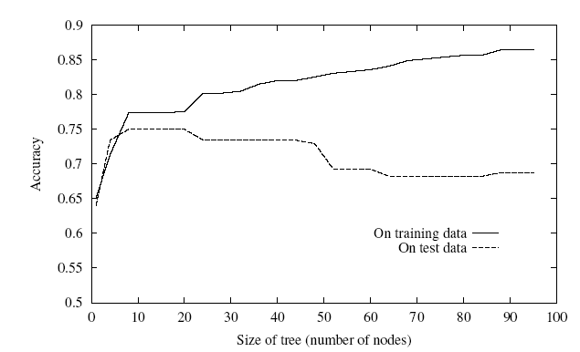
Overfitting
One of the biggest problems with decision trees is Overfitting

Slide 28
Avoid Overfitting
stop growing when split not statistically significant
grow full tree, then post-prune
Select “best” tree:
measure performance over training data
measure performance over separate validation data set
min( |tree|+|misclassifications(tree)|)

Slide 29
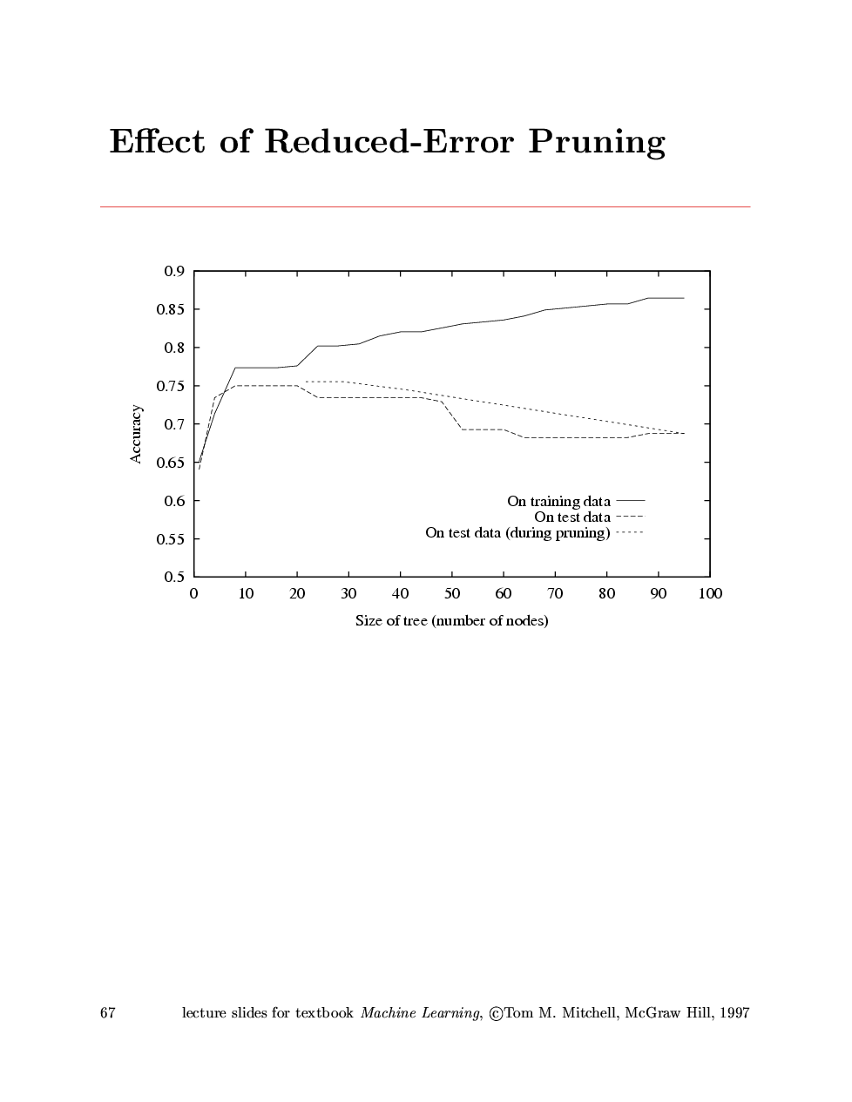
Effect of Reduced Error Pruning

Slide 30
Converting a Tree to Rules
Outlook
Sunny
Overcast
Rain
Humidity
Yes
Wind
High
Normal
Strong
Weak
No
Yes
No
Yes
R₁: If (Outlook=Sunny) ∧ (Humidity=High) Then PlayTennis=No
R₂: If (Outlook=Sunny) ∧ (Humidity=Normal) Then PlayTennis=Yes
R₃: If (Outlook=Overcast) Then PlayTennis=Yes
R₄: If (Outlook=Rain) ∧ (Wind=Strong) Then PlayTennis=No
R₅: If (Outlook=Rain) ∧ (Wind=Weak) Then PlayTennis=Yes

Slide 31
Continuous Valued Attributes
Create a discrete attribute to test continuous
Temperature = 24.5⁰C
(Temperature > 20.0⁰C) = {true, false}
Where to set the threshold?
Temperature
15⁰C
18⁰C
19⁰C
22⁰C
24⁰C
27⁰C
PlayTennis
No
No
Yes
Yes
Yes
No

Slide 32
Unknown Attribute Values
What if some examples have missing values of A?
Use training example anyway sort through tree
If node n tests A, assign most common value of A among other examples sorted to node n.
Assign most common value of A among other examples with same target value
Assign probability p_{i} to each possible value v_{i} of A
Assign fraction p_{i} of example to each descendant in tree
Classify new examples in the same fashion

Slide 33
Cross-Validation
Estimate the accuracy of an hypothesis induced by a supervised learning algorithm
Predict the accuracy of an hypothesis over future unseen instances
Select the optimal hypothesis from a given set of alternative hypotheses
Pruning decision trees
Model selection
Feature selection
Combining multiple classifiers (boosting)

